Slide 1
DATA 698 Project Update
By Calvin Wong

Slide 2
Data Cleaning
Merging dataset Florida State Workers’ Compensation with NAPEO Survey Ratings
Removing NA’s
Clustering Algorithms do not work when NA’s exist
Use simple full value means to replace NA’s
Remove it entirely to hasten project completion
The use of Longtitude/Latitude with Google Maps Geocoding API for future use

Slide 3
NomClust Package
The newest Hierarchical Cluster Analysis package
Solves clustering anomalies by providing up to 11 evaluation criteria's
Perform the complete clustering process, where the input is data matrix X, and the output consists of cluster membership variables, and a set of evaluation criteria
Slow performance because each datapoint is evaluated against the others – 4 hour runtime

Slide 4
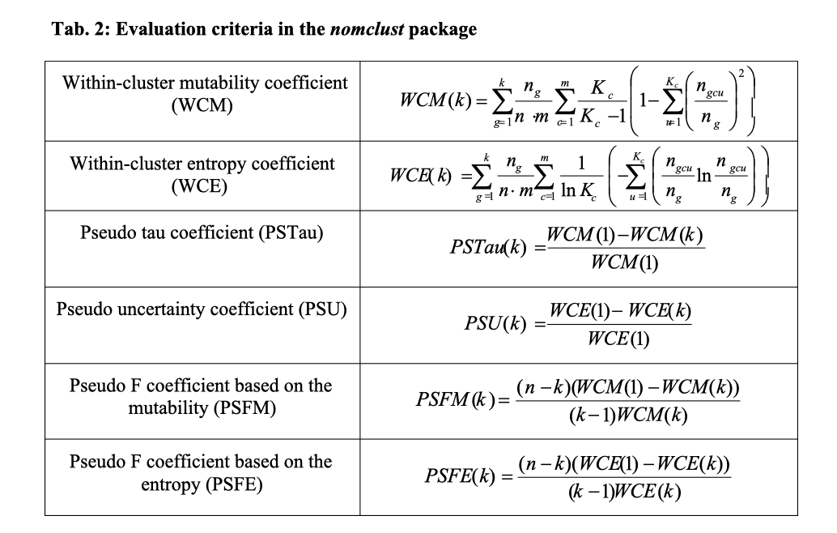
Project Completion
Concepts of evaluation methods are difficult to understand mathematically
Understanding business dynamics is important in the write up

Slide 5
Future work
Comparative analysis between Clustering outputs versus actual Tier designations
Train/Test set to gather accuracy of nomclust functions
Breakout of Tiers into 5 levels with clear designations
Business case where competitive advantage can be gained

